Slide 1
Final Project STAT-601 12/10/2018
Abstract
Exploratory research analysis
Correct response variable
Question of interest
Average total time to type the passcode how changes over time
Formal statistical analysis with post hoc test
By
Md Mahi Uddin

Slide 2
Problem Statement
This exploratory analysis will include to develop proper response variables which is relevant to question of interest and need to justify the choice of final summary statistic. Formal and appropriate statistical analysis of the data set need to be done with post hoc analysis.
Follow the three steps given in the instruction

Slide 3
Background
In this report, we will do exploratory analysis with given datasets to identify correct response variables which related to our question of interest. Then we will follow the rest of the procedure.
Passcode: .tie5Roanl

Slide 4
Dataset Descriptions
51 individuals
8 days
400 passcode typed each individual
50 times in each session in total 8 session
34 variables
20400 observations
keystroke dynamics data set
.tie5Roanl

Slide 5
Question of interest
Whether the responses of amount of average total time to type the passcode that differ
How the different session index with subject affect the response.
Does the mean of the amount of total time significantly relate with session index and individuals who type the passcode over the session?
?

Slide 6
Nature of the datasets
Our dataset is longitudinal data (look like) because it has a type of repeated measures and times are measured at multiple days for each subject where same number of time points per subject equally spaced under the same conditions.
Types of variables
1 factor
2 integer
31 numeric

Slide 7
Exploratory Analysis
We have to careful about the account for correlation between the measurements from the same subject.
Denying correlation may lead to wrong inference, bias or less precise estimates.
We do not have any missing variables as well as no duplicate rows.
We figure out the average total time for all subject as well as average total time for all session index.
We also graphically represent those information with different interaction.
*Negative value basically come from the time difference not from the direct time.
*One finger can go to type a character before finishing of typing of the previous character. So this gap can be negative.

Slide 8
Exploratory Analysis
All variable list
subject, sessionIndex, rep, H.period , DD.period.t , UD.period.t, H.t, DD.t.i, UD.t.i, H.i, DD.i.e, UD.i.e, H.e , DD.e.five, UD.e.five, H.five, DD.five.Shift.r, UD.five.Shift.r, H.Shift.r, DD.Shift.r.o, UD.Shift.r.o, H.o, DD.o.a, UD.o.a, H.a, DD.a.n, UD.a.n, H.n, DD.n.l, UD.n.l, DD.l.Return, UD.l.Return, H.Return
Variables!!

Slide 9
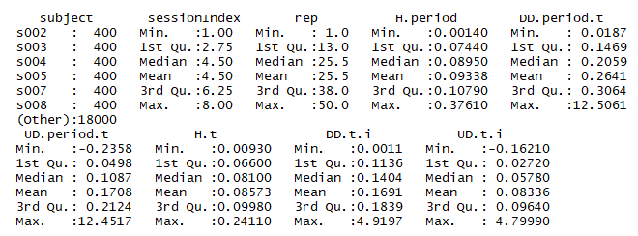
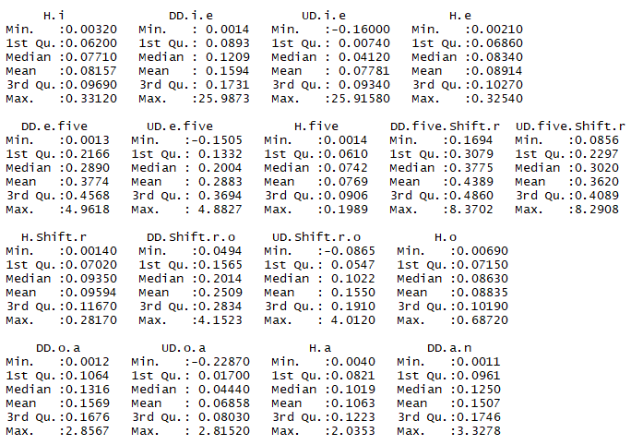
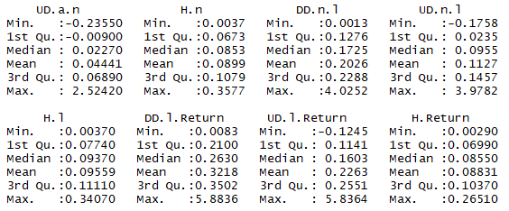
Exploratory Analysis
Summary of whole data set.

Slide 10
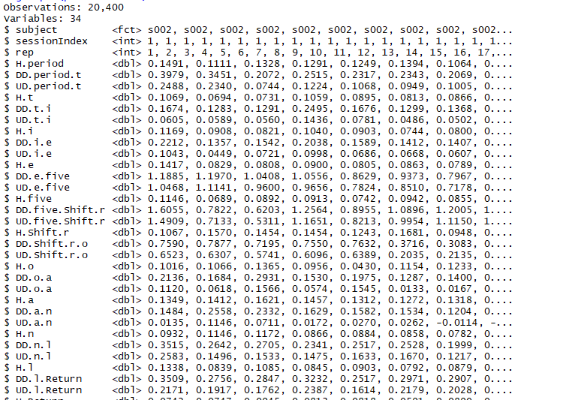
Exploratory Analysis
Glimpse for find the first few observations and type of the variables.

Slide 11
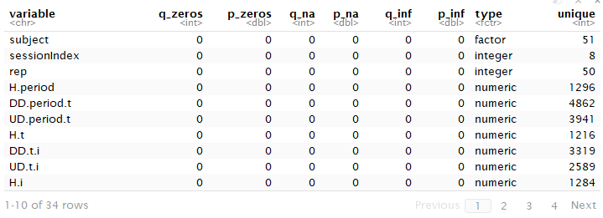
Exploratory Analysis
Uniqueness of the variables and types of the variables.

Slide 12
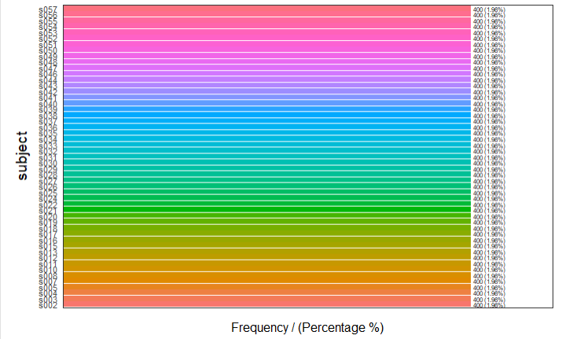
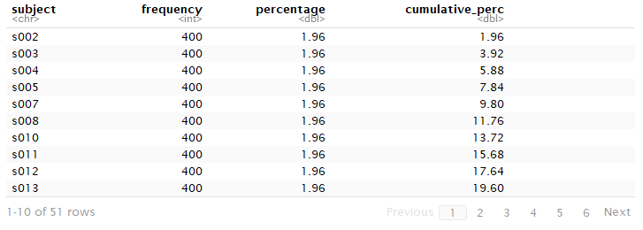
Exploratory Analysis
Subject wise frequency and cumulative frequency.

Slide 13
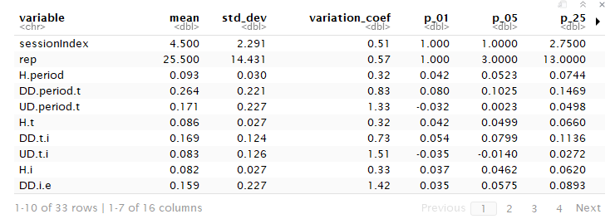
Exploratory Analysis
Profile of the different information including skewness, kurtosis, percentile, variation, and ranges.

Slide 14
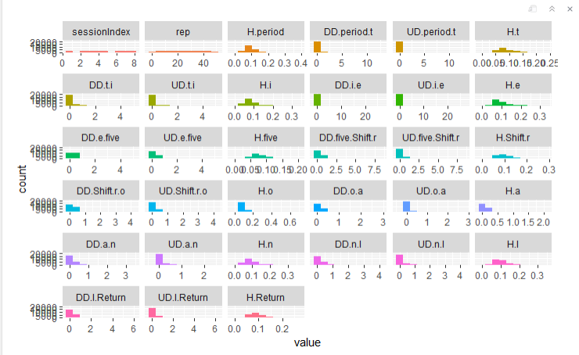
Exploratory Analysis
Graph with count for all variables.

Slide 15
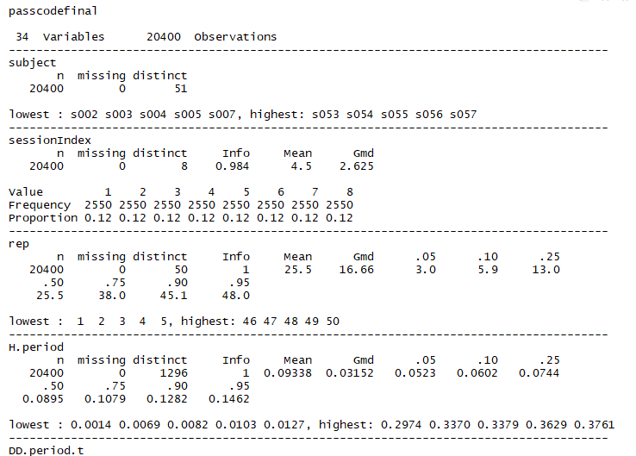
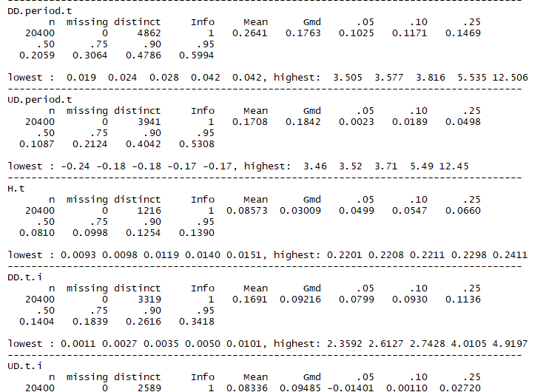
Exploratory Analysis
Short description of all variables with value, frequency proportion, lowest and highest value.

Slide 16

Exploratory Analysis
Find the missing value.
No Missing
693600/20400=34

Slide 17


Exploratory Analysis
Find the duplicate rows.

Slide 18
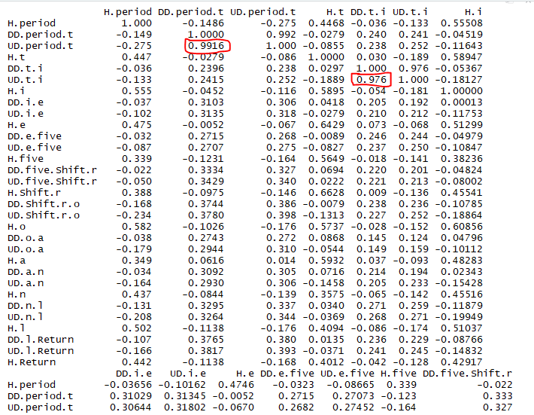
Exploratory Analysis
Correlation of all numerical variables.
Found 10 Variables are highly correlated
DROP THEM
DD.period.t ,DD.t.i, DD.i.e, DD.e.five, DD.five.Shift.r, DD.Shift.r.o, DD.o.a, DD.a.n, DD.n.l, DD.l.Return

Slide 19
Exploratory Analysis
H.period, UD.period.t, H.t, UD.t.i, H.i,UD.i.e, H.e, UD.e.five,H.five, UD.five.Shift.r,H.Shift.r,UD.Shift.r.o, H.o, UD.o.a, H.a, UD.a.n, H.n, UD.n.l, H.l, UD.l.Return, H.Return
UD, H and H.Return

Slide 20
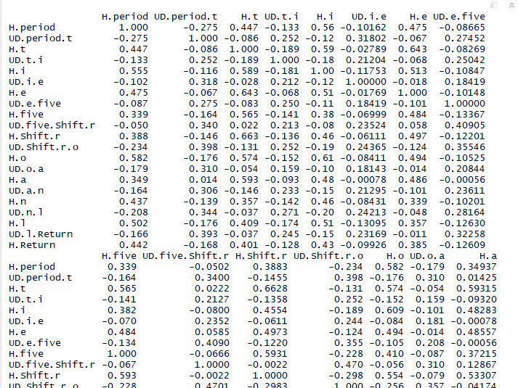
Exploratory Analysis
Separate subset for DD, UDH and correlation within subset.
No more correlation

Slide 21
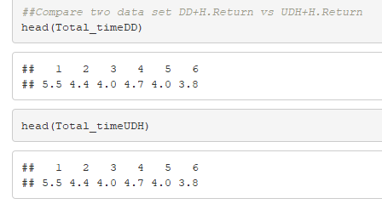
Exploratory Analysis
Compare two subset
Yeh, Both are the same

Slide 22
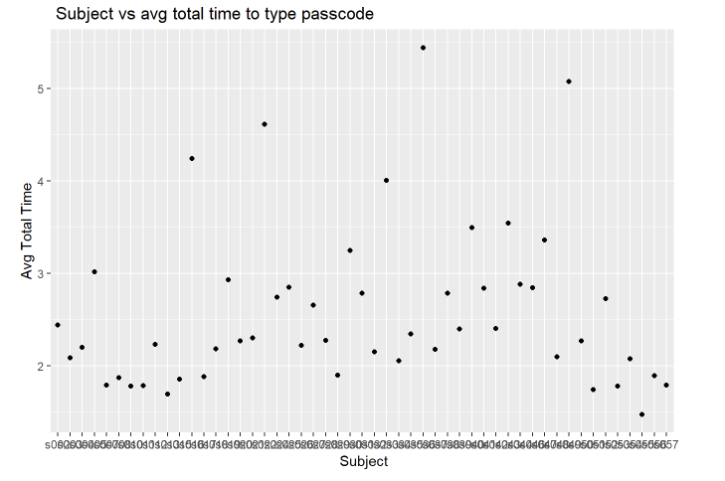
Exploratory Analysis
Subject wise average total time

Slide 23
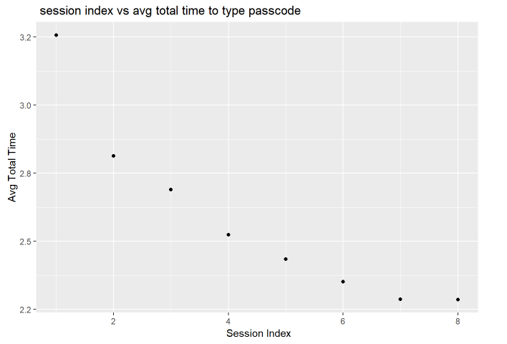
Exploratory Analysis
Session Index wise average total time
It is decreased over time!!!

Slide 24
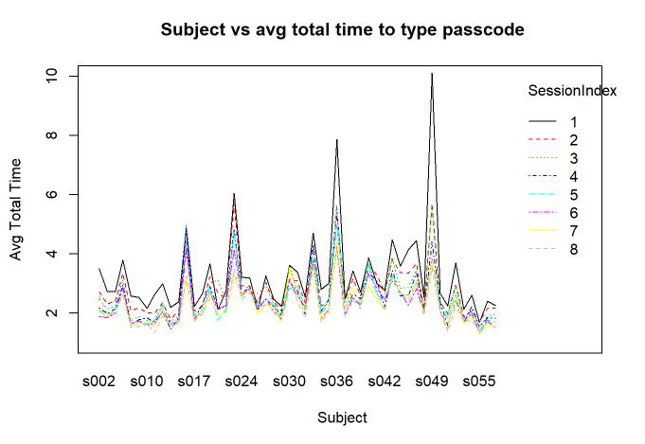
Exploratory Analysis
Interaction

Slide 25
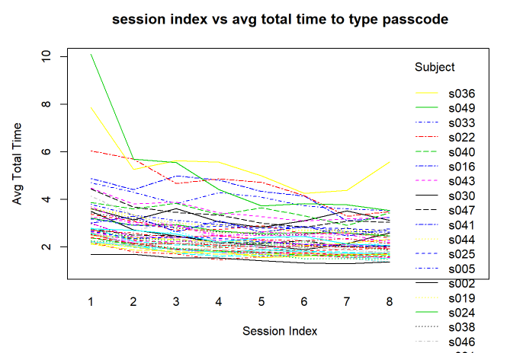
Exploratory Analysis
Interaction
More precise picture given on next slide

Slide 26
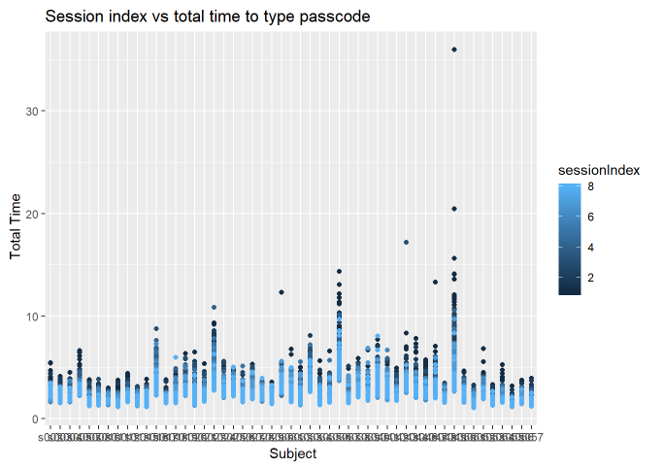
Exploratory Analysis
Interaction

Slide 27
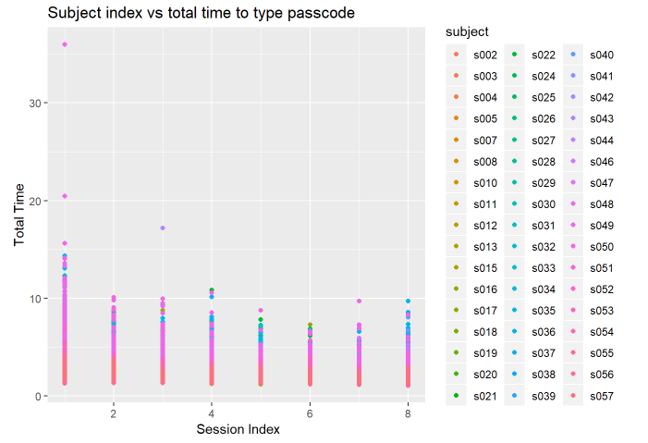
Exploratory Analysis
Interaction

Slide 28
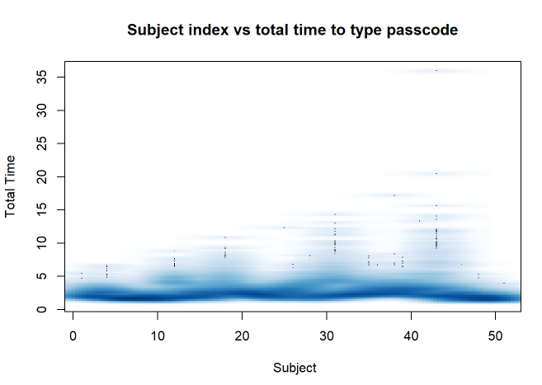
Exploratory Analysis
Relationship

Slide 29
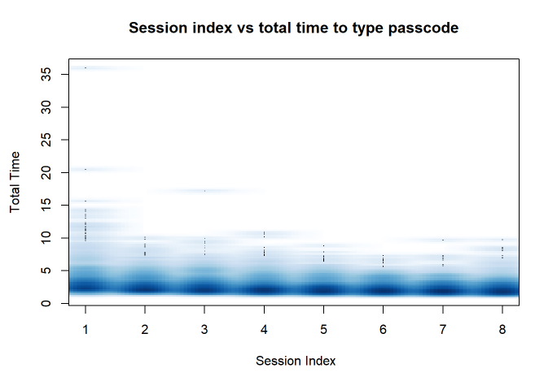
Exploratory Analysis
Relationship

Slide 30
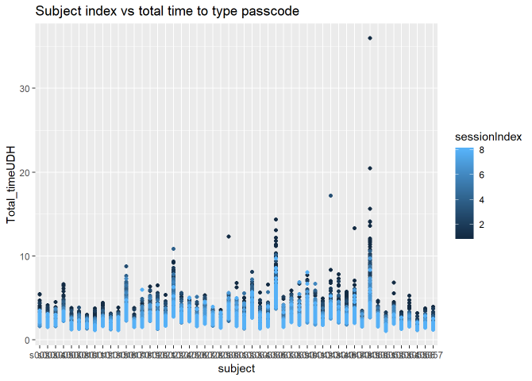
Exploratory Analysis
Interaction

Slide 31
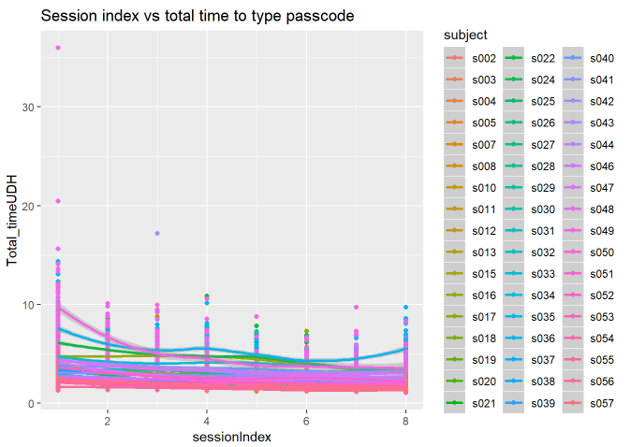
Exploratory Analysis
Interaction

Slide 32
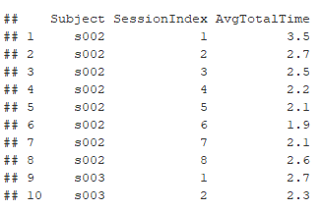
Exploratory Analysis
Final Data

Slide 33
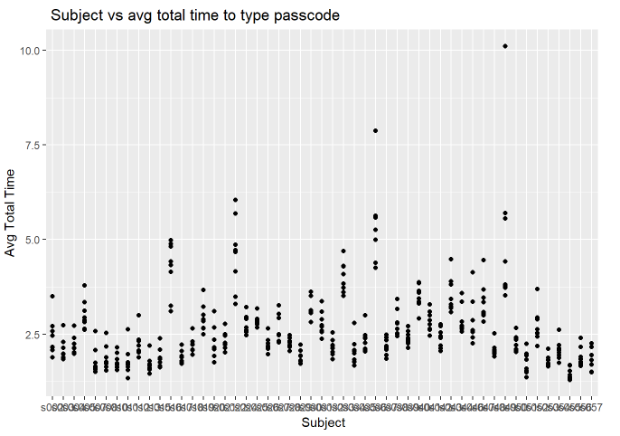
Exploratory Analysis
Relation from final data

Slide 34
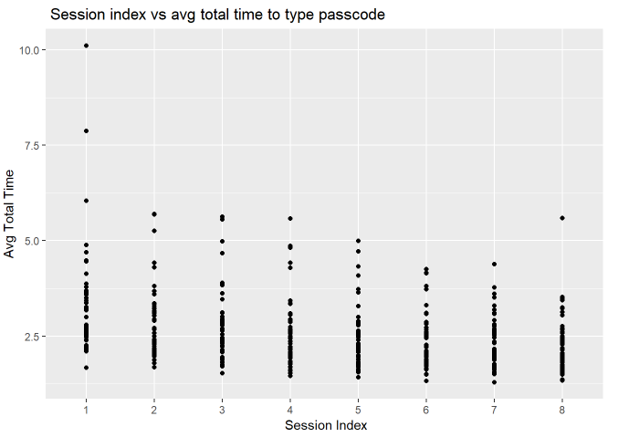
Exploratory Analysis
Relation from final data

Slide 35
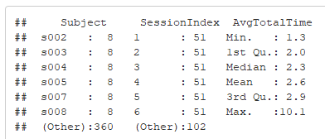
Exploratory Analysis
Summary from final data

Slide 36
Find the Response Variable
Seconds to type the each key of keyboard of a password consecutively. All response was measured for all characters related type the given passcode are DD, H, UD and H.Return.
Conventionally we can assume that response may decrease with time as they will become more skilled over time.
Avg Total Time

Slide 37
Developing of the response variable
We have enough variables to perform different types of regression model.
Important variable to find the total time to type the passcode.
Simple equation for finding total time: DD=H+UD.
DD variables or H and UD variables.
Last return key (H.Return). So, in both way need to count H.Return time.
It is statistically satisfy that we can dropped all 10 DD variables as they are highly correlated (All correlation over 0.90) with UD variables.
We add all H and UD variables with H.Return to get the total time to type the passcode.
DD+ H.Return =H+UD+ H.Return
34 variables in whole dataset
10 DD variables
10 H variables except H.Return
10 UD variables
Total Time = All H + All UD + H.Return.

Slide 38
Finding the correct Model
It is best to find the effect thorough mixed effect model since our data contain repeated measures. In our data set and question design suggest that we have multiple measures per subject as data taken for 8 session. So this repeated measures should include in our model.
Each subject gave multiple typing responses. Multiple responses from the same subject cannot be regarded as independent from each other.
Every person has slightly different typing practice and this is going to be an idiosyncratic factor that affects all responses from the same subject, thus rendering these different responses inter-dependent rather than fully independent.
Typing dynamics may differ over time. The way we are going to deal with this situation is to add a random and fixed effect for subject. This allows us to resolve this non-independence by assuming a different baseline average total time for each subject.
Mixed effect model

Slide 39
Finding the correct Model
Subject one have a mean typing time across different session and subject two also have different mean typing time over time and so on.
From the average total typing time and session index graph, we observe that the average total typing time decrease over time but typing time across the individuals also varied. We can model these individual differences by assuming different random intercepts for each subject.
That means each subject is assigned a different intercept value and the mixed model estimates these intercepts.
So, we can use the mixed model as formal and appropriate statistical analysis of the given data set. Within mixed model, we can identify the random effect as well as fixed effect.

Slide 40
Finding the correct Model
We add a random effect for “subject”, and this characterizes idiosyncratic variation that is due to individual differences.
Assume an intercept that’s different for each subject. The formula of our model, it is expected that multiple responses per subject, and these responses will depend on each subject’s baseline level.
This effectively resolves the non-independence that stems from having multiple responses by the same subject.
Mixed = Random + Fixed

Slide 41
Finding the correct Model
We add fixed effect ‘session index’ to predict average total typing time of given passcode controlling for by subject.
lmer

Slide 42
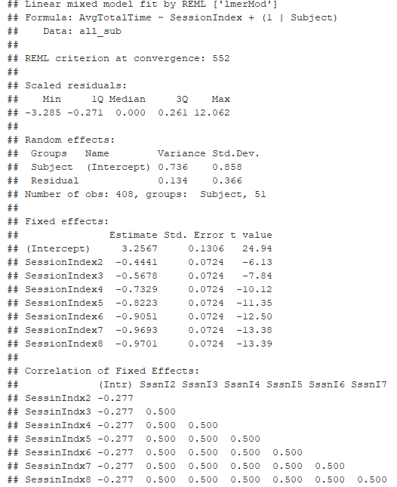
Correct Model
Our result

Slide 43
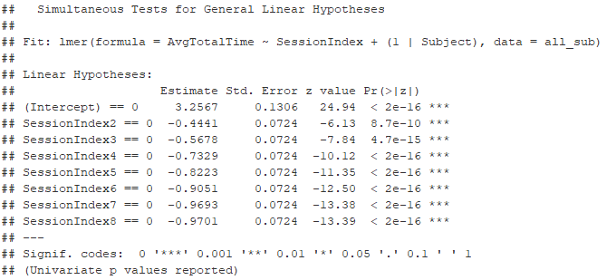
Correct Model
cftest

Slide 44
Post-hoc Analysis
ANOVA to tell us whether we have an overall difference among the session index, but it does not tell us which specific session differed.
From ANOVA result, we can say about overall significant. Post hoc analyses attempt to control the experiment wise error rate in the same manner that the one way ANOVA is used instead of multiple t tests.
emmeans to find out the multiple comparison among the session. By this way we will able to get the potential pairwise comparisons more precisely pairwise differences of session index. Finally we use the
The glht to make sure the multiple comparisons of means from our lmer model and find their multiple session wise statistical significance.
ANOVA
Emmeans
glht

Slide 45
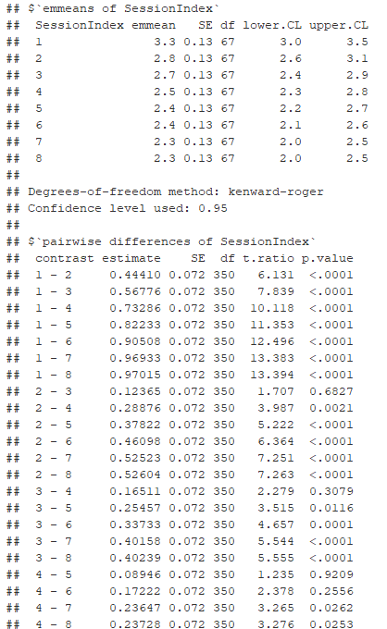
Post-hoc Analysis
emmeans

Slide 46

Post-hoc Analysis
ANOVA

Slide 47
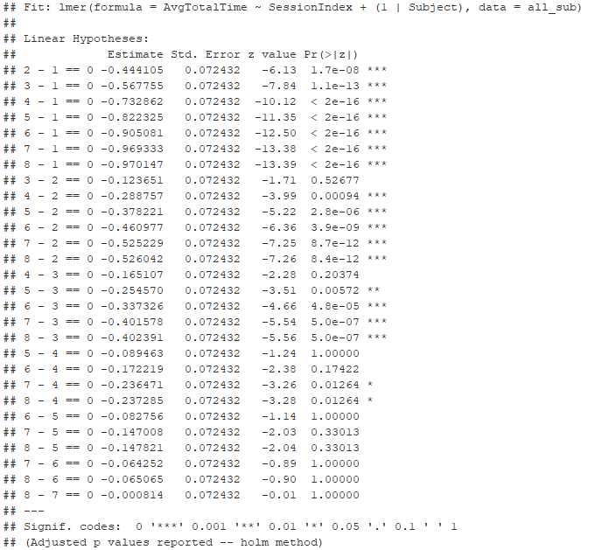

Post-hoc Analysis
Tukey Contrasts

Slide 48
Conclusion
The typing dynamics changes over time
The average total time to type the given passcode have decreased with the increase of session index.
Most of the beginning pairs are significant
Few pairs the last sessions are not significant.
The mixed effect model suggest that the typing dynamics statistically and significantly changes over time.

Slide 49
References
https://www.youtube.com/watch?v=Ioayy73PvsE
http://www.bodowinter.com/tutorial/bw_LME_tutorial.pdf
https://stats.stackexchange.com/questions/237512/how-to-perform-post-hoc-test-on-lmer-model
https://statistics.laerd.com/statistical-guides/one-way-anova-statistical-guide-4.php
And Class Lecture

